Slide 1


Capstone Project: Exploring Coffee Quality Data
Presented by :
Name : Neeli Neelima Krishna
Student ID: S10685

Slide 2


Project Overview
The primary goal of this project is to leverage the rich dataset provided by CQI to understand the factors that contribute to coffee quality.
By Systematically evaluating various sensory attributed like Aroma,Acidity,Aftertaste,Flavour etc. ,the project aims to identify key factors influencing coffee quality.
The data includes a range of information on coffee production, processing, and sensory evaluation. It also contains data on coffee genetics, soil types, and other factors that can affect coffee quality.

Slide 3
Business Objective
The Coffee Quality Institute (CQI) is a non-profit organization that works to improve the quality and value of coffee worldwide. It was founded in 1996 and has its headquarters in California, USA.
CQI's mission is to promote coffee quality through a range of activities that include research, training, and certification programs. The organization works with coffee growers, processors, roasters, and other stakeholders to improve coffee quality standards, promote sustainability, and support the development of the specialty coffee industry.

Slide 4



Technical Stacks

Slide 5



Exploratory Data Analysis

Slide 6
data
The data includes a range of information on coffee production, processing, and sensory evaluation. It also contains data on coffee genetics, soil types, and other factors that can affect coffee quality.

Slide 7
Sensory evaluations (coffee quality scores)
Aroma: Refers to the scent or fragrance of the coffee.
Flavor: The flavor of coffee is evaluated based on the taste, including any sweetness, bitterness, acidity, and other flavor notes.
Aftertaste: Refers to the lingering taste that remains in the mouth after swallowing the coffee.
Acidity: Acidity in coffee refers to the brightness or liveliness of the taste.
Body: The body of coffee refers to the thickness or viscosity of the coffee in the mouth.
Balance: Balance refers to how well the different flavor components of the coffee work together.
Uniformity: Uniformity refers to the consistency of the coffee from cup to cup.
Clean Cup: A clean cup refers to a coffee that is free of any off-flavors or defects, such as sourness, mustiness, or staleness.
Sweetness: It can be described as caramel-like, fruity, or floral, and is a desirable quality in coffee.

Slide 8
data Preprocessing
Changed column names accordingly
Removed Duplicate id,Empty and Error rows.
Splited Altitude column through delimiter, drawn an Average Altitude column and created Altitude Range column.
Bag Weight – Extracted kg from weight and converted to Whole Number.
Grading Date – Replaced st,nd,rd,th with space & Augu to August and changed data type to date.
Created Sensory Attributes table by unpivoting attribute name and score.

Slide 9
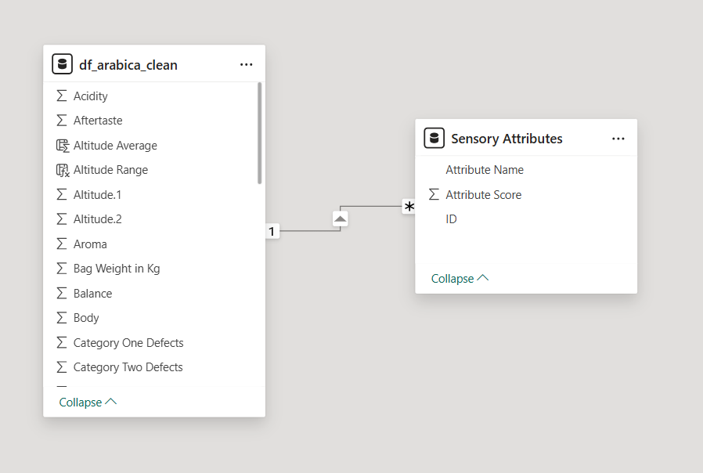
Data Modelling
Created one to many Relationship for ID between the 2 tables.

Slide 10

Visualizations

Slide 11
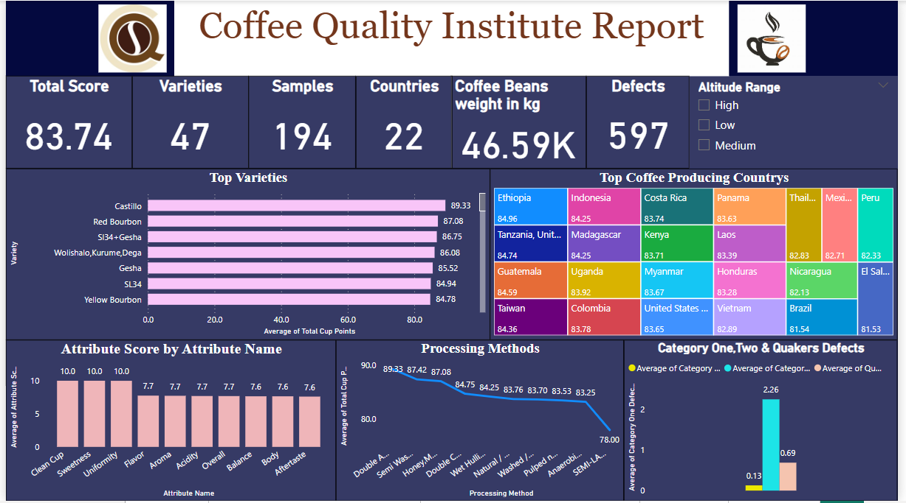

Slide 12
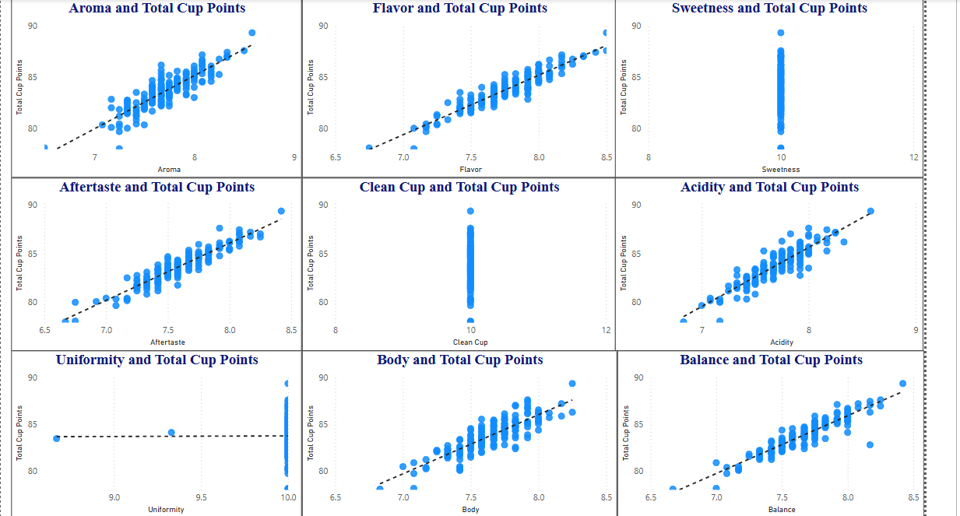
Sensory Attributed vs Total Cup Points

Slide 13
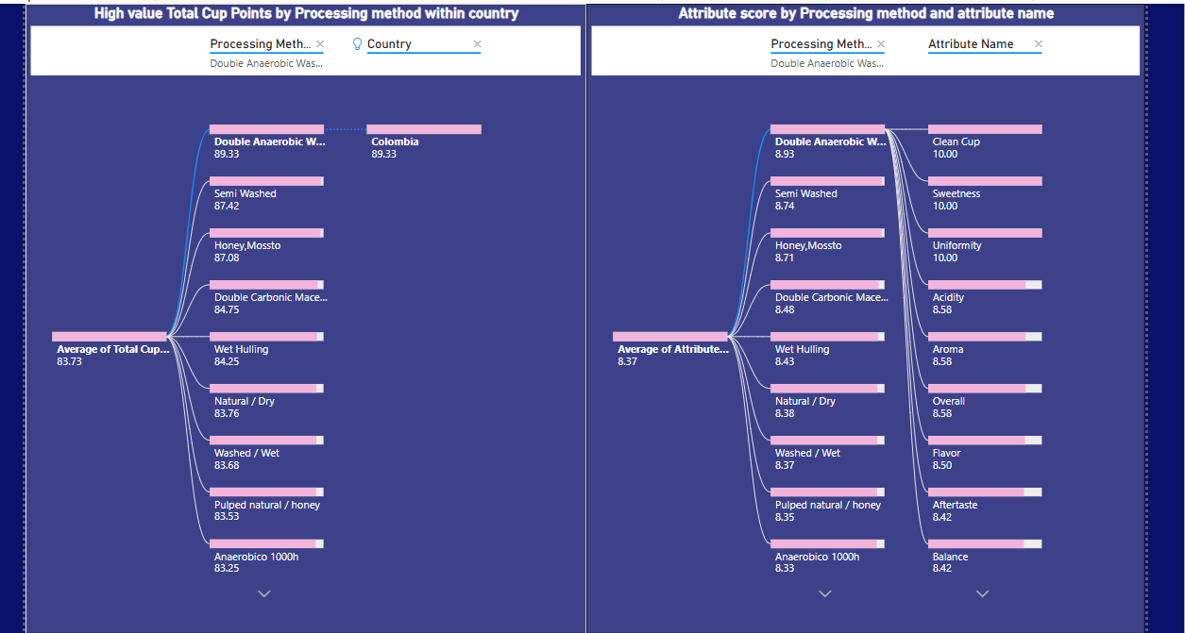
Correlation Between Variables

Slide 14
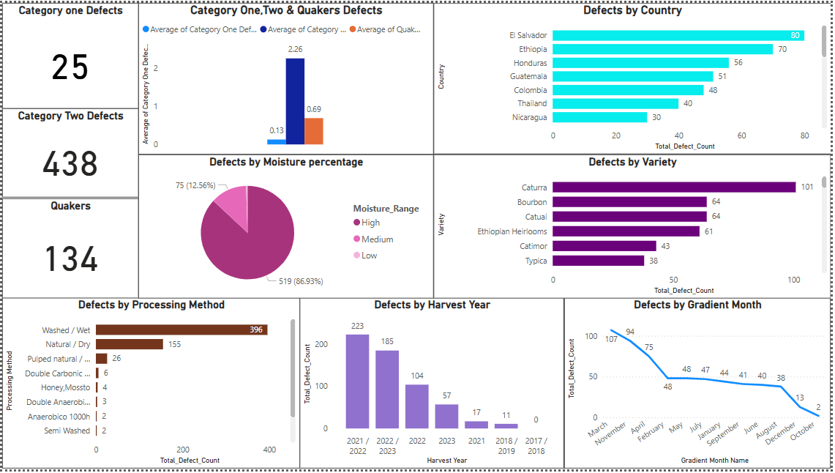
Defects Trends

Slide 15
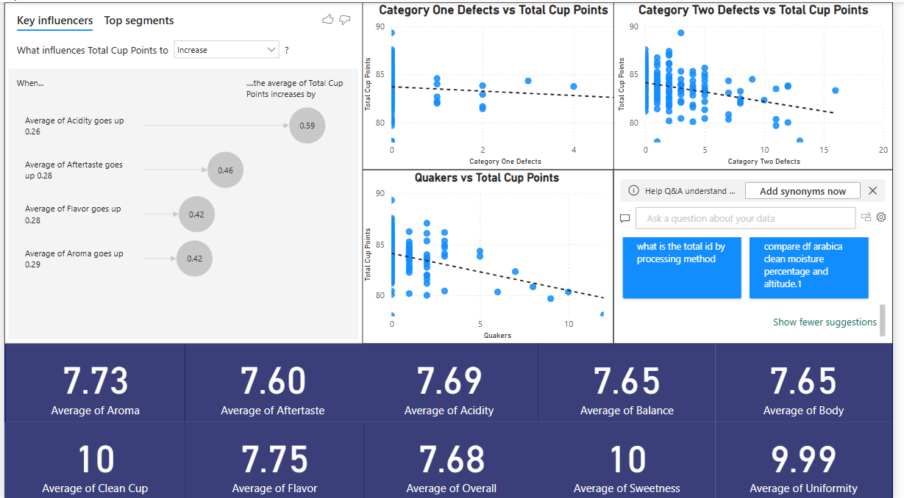
Defects Trends

Slide 16
Insights
What are the key determinants of coffee quality as evaluated through sensory attributes such as aroma, flavor, acidity, etc.?
Aroma,Flavour,Acidity,Aftertaste,Balance are the key attributed that impact the coffee quality.
Castillo, Redbourbon are top 2 varieties of coffee beans that produce high quality coffee.

Slide 17
Insights
Is there a correlation between processing methods, origin regions, and coffee quality scores?
Top 3 countries producing high coffee quality beans are Ethiopia, Tanzania, Guatemala.
Popular processing methods producing high quality coffee are Double Anaerobic Washed, Semi Washed, Honey-Mosto.
Combination of Ethiopia country & Natural/Dry processing method producing high quality coffee and combination of Columbia country & Double Anaerobic Washed processing method producing High Quality Coffee.

Slide 18
Insights
Can we identify any trends or patterns in defect occurrences and their impact on overall coffee Quality?
Category two defects are more than category one defects.
Higher Altitude regions are producing fewer defective beans.
Beans with High moisture range above 10% have more defective beans.
Beans Graded in March, November, April have more defect beans.
Cattura Variety is having more category two defective beans.

Slide 19
Insights
Washed/wet method have more defective beans followed by natural method.
Harvest year 2021/2022,2022/2023 has more defect beans.

Slide 20
Insights
How do different variables interact to influence the Total Cup Points, which represent an overall measure of coffee quality?
Attributes like Acidity, Aroma, Flavor, Aftertaste, Balance influences the quality of the coffee. Increase in these attributed increase total cup points.
High Defects leads to lower cup points.
Combination of Ethiopia country with Gesha Variety and Natural/Dry processing method produce high quality coffee.
Combination of Castillo variety in Columbia country with Double Anerobic washed method also producing high quality coffee.

Slide 21

Thank you

